Slide 1
DRAW:
Deep Recurrent Attentive Writer
Nasir Khalid | 65082
Yousif Khaireddin | 63618
May 13th 2019

Slide 2
Outline
Recap
Introduction to DRAW
Main Features
Architecture
Selective Attention
Results
References

Slide 3
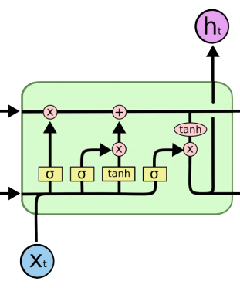
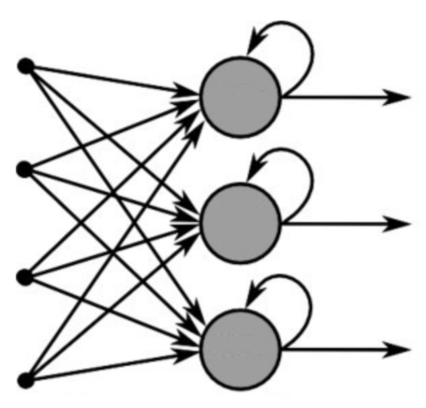
Recap
Recurrent Neural Networks
A Standard RNN [1]
LSTM Network [2]
Notes:
Standard RNN used for sequential data by using previous neuron states as inputs.
LSTM expands on the original ones by including multiple different features that deal with the vanishing gradients problem such as the forget gate, cell state, output, new information etc.

Slide 4
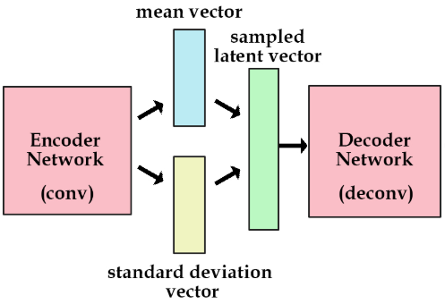

Recap
Variational Autoencoder
Force autoencoder to generate latent vectors that roughly follow a unit gaussian distribution
Loss function shown below:
Reconstruction Error
KL
Divergence
Variational Autoencoder [3]

Slide 5
DRAW
Intuition
Most image generation is ’one-shot’.
When given an input, the output is produced immediately.
Humans do not really draw in this manner.
DRAW mimics the human approach to generation
Shown is a typical autoencoder output after a few Epochs, all pixels manipulated at once
Typical Autoencoder Output over Epochs [4]
Notes:
Y

Slide 6
DRAW
Intuition
Most image generation is ’one-shot’.
When given an input, the output is produced immediately.
Humans do not really draw in this manner.
DRAW mimics the human approach to generation
Shown is a typical DRAW output over time
DRAW Output [5]
Notes:
Y

Slide 7
DRAW
Main Features
Encoder and Decoder are Recurrent Networks
Decoder output are successively added over time to get output
An 'Attention' mechanism is used which tells the network where to focus on every loop
Notes:
Y

Slide 8
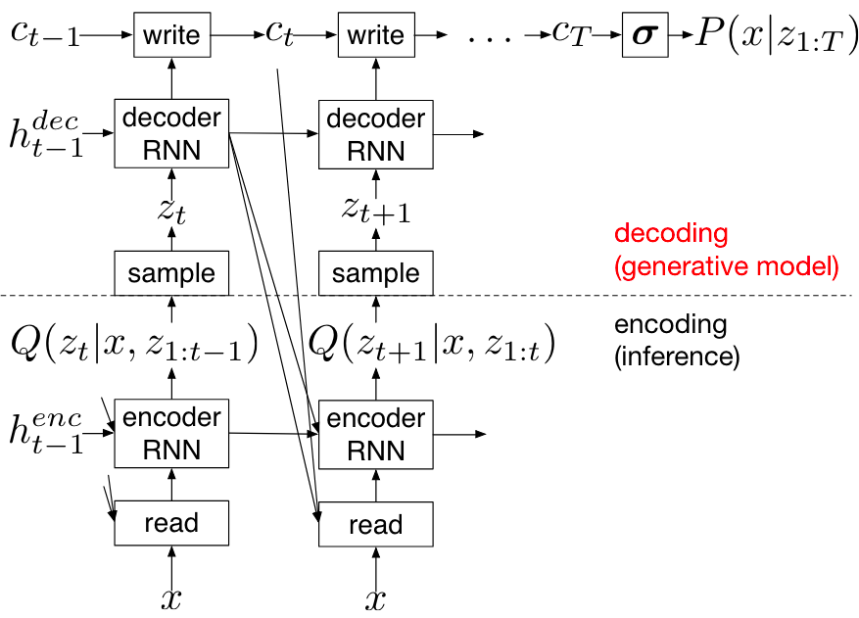
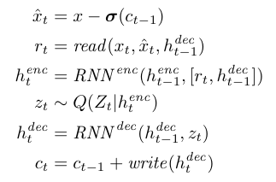
DRAW
Architecture
LSTM Encoder and Decoder
The 6 equations below are repeated:
DRAW Equations [5]
DRAW Architecture [5]
Notes:
Y

Slide 9
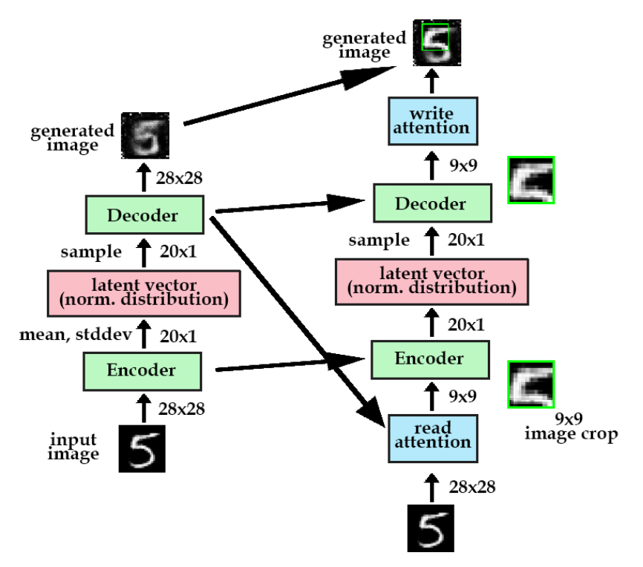
Selective Attention
Read and Write
Read function takes a certain portion of the image and passes it forward.
Write function puts the same ‘cropped’ portion back on in the original image.
Cropping is a good way to view the operation but it is not exactly what happens
DRAW Example [3]

Slide 10
Selective Attention
Explaining the ‘Crop’
The cropping is actually a collection of 2D gaussian filters.
The filters are placed at centers X, Y and have dimensions N X N.
We stride the filters along to get multiple values along each timestep. Also have intensity values for each one.
Gaussian Filters
DRAW Example [3]

Slide 11
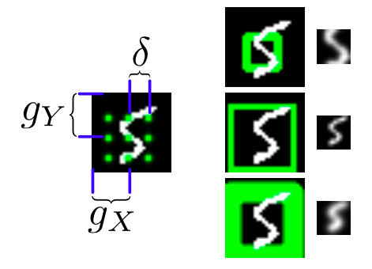
Selective Attention
Explaining the ‘Crop’
First one is small stride and intensity
Second is large stride and small intensity
Last has high stride and high intensity.
Initial parameters are set so as to cover the whole image
The Write function pulls parameters from the Decoders previous state
DRAW Attention Example [5]

Slide 12
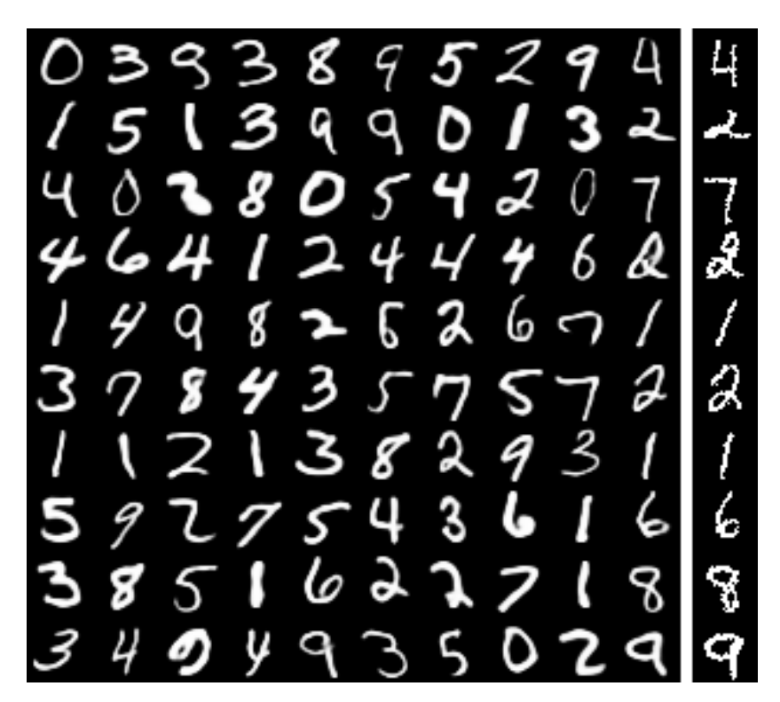
Results
Generating MNIST Data
MNIST Generation[1]
Notes:
Y

Slide 13
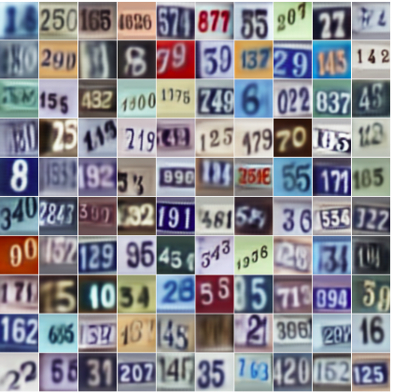
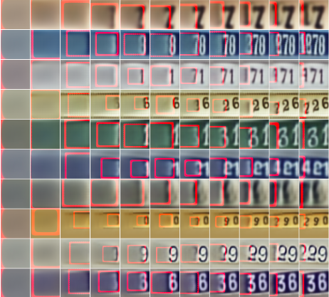
Results
Generating Street Numbers
Street number generation [5]
Notes:
Y

Slide 14
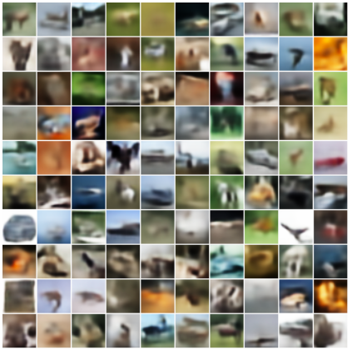
Results
Generating Street Numbers
CIFAR 10 Generation [5]
Notes:
Y

Slide 15
References
[1] Week 10, Lecture Slides 01 for ELE49409 by Dr. Usman Tariq
[2] Week 10, Lecture Slides 02 for ELE49409 by Dr. Usman Tariq
[3] K. Frans, “Variational Autoencoders Explained,” kevin frans blog, 05-May-2017. [Online]. Available: http://kvfrans.com/variational-autoencoders-explained/. [Accessed: 11-May-2019].
[4] Kennycason, “kennycason/neural_network_kotlin,” GitHub, 05-May-2018. [Online]. Available: https://github.com/kennycason/neural_network_kotlin. [Accessed: 11-May-2019].
[5] Gregor, Karol, Danihelka, Ivo, Alex, Rezende, D. Jimenez, and Daan, “DRAW: A Recurrent Neural Network For Image Generation,” arXiv.org, 20-May-2015. [Online]. Available: https://arxiv.org/abs/1502.04623. [Accessed: 11-May-2019].

